Slide 1


Machine Learning Summary & Revision
BITS Pilani
Anita Ramachandran
2021
Pilani | Dubai | Goa | Hyderabad

Slide 2

Terms
Supervised & unsupervised learning
Regression, classification
Hypothesis, class
Generalization
Version space
Noise
Inductive bias
Underfitting, overfitting
Bias, variance, bias-variance tradeoff
More complex & less complex hypothesis
Triple tradeoff
Regularization
Evaluating model performance
Bayesian learning
Likelihood, prior, posterior probability
MAP and MLE hypotheses
Consistent learners
Brute force MAP learning algorithm
Bayes optimal classifier
Gibbs algorithm
Naïve Bayes classifier
BITS Pilani, Deemed to be University under Section 3 of UGC Act, 1956

Slide 3
More terms
Model parameters and hyperparameters
Lazy and Eager learners
Parameters
Required by the model when making predictions.
Estimated or learned from data
May not be set manually by the practitioner
Saved as part of the learned model
Hyperparameters
Used in processes to help estimate model parameters
Specified by the practitioner
They can often be set using heuristics
Tuned for a given predictive modeling problem
Lazy Learners
Delays the process of modeling the training data until it is needed to classify the test examples
No model building, but expensive to classify test examples
Eg: kNN
Eager Learners
Learns a model that maps the input attributes to the class label as soon as the training data becomes available
Builds models, fast classification of test examples
Eg: Decision tree, rule based classification, Naïve Bayes, SVM
BITS Pilani, Deemed to be University under Section 3 of UGC Act, 1956

Slide 4
More terms
Generative models/functions
Use prior class probabilities and apply Baye’s theorem to find posterior probabilities
Then determine class membership for each new input
Learns the joint probability distributions of the data wrt to the class
Assume some functional form for P(Y), P(X | Y)
Estimate parameters of P(X | Y), P(Y) directly from training data
Use Bayes rule to calculate P(Y | X)
E.g., Naive Bayes which directly estimates parameters for P(Y) and P(X | Y)
Discriminative models/functions
Approaches that model posterior probabilities
First solve the inference problem of determining the posterior class probabilities
Then subsequently assign each new input to one of the classes
Assume some functional form for P(Y | X)
Estimate parameters of P(Y | X) directly from training data
Eg: Logistic regression (learning P(Y|X) directly)
BITS Pilani, Deemed to be University under Section 3 of UGC Act, 1956

Slide 5
Bayesian Learning
How do we estimate the class-conditional probabilities for discrete attributes in NB classification?
How do we estimate the class-conditional probabilities for continuous attributes in NB classification?
Using Bayesian analysis, show that any learning algorithm that minimizes the squared error between the output hypothesis predictions and the training data will output a maximum likelihood hypothesis
Prove that MLE is a special case of MAP, where the prior is uniform.
Characteristics of NB classification
Performs better in categorical input variables when compared to numerical variables
Zero frequency problem
Performs well where the assumption of independence holds good
Used when the relationship between the attribute set and the class variable is non-deterministic
BITS Pilani, Deemed to be University under Section 3 of UGC Act, 1956

Slide 6
Linear Models for Regression
Derive the gradient descent expression for multivariate linear regression, with regularization
What is the effect of regularization on model fitting?
How does large values of regularization parameter result in simpler hypothesis?
Show that in Bayesian Linear Regression, maximizing MLE is the same as minimizing sum of squares error
BITS Pilani, Deemed to be University under Section 3 of UGC Act, 1956

Slide 7
Linear Models for Classification
Why cannot we use the MSE function as the cost function for logistic regression?
What are the ways to estimate parameters for logistic regression?
Value of the weights wi in terms of the parameters estimated by the GNB classifier
Maximizing conditional data likelihood using gradient ascent
Derive an expression for Gradient descent rule for logistic regression with regularization
Derive the form of P(Y | X) entailed by the assumptions of a Gaussian Naive Bayes (GNB) classifier.
BITS Pilani, Deemed to be University under Section 3 of UGC Act, 1956

Slide 8
Linear Models for Classification
Show that the parameters wi in Logistic Regression can be expressed in terms of the Gaussian Naive Bayes parameters
Derive the equation and shape of decision surface for real-valued random variable X=<X1, X2, .., Xn> and boolean output Y for logistic regression
Consider the hypothesis function h(x)=w₀+w₁ x₁+ w₂x₂ + w₃x₁²+w₄x₂² with learnt w=<w₀, w₁, w₂, w₃, w₄> = <-36, 0, 0, 4, 9>. What is the equation and shape of the decision boundary g(x₁,x₂) for logistic regression given by P(Y=1 | X) = 1/(1+e^{(h(x))})?
BITS Pilani, Deemed to be University under Section 3 of UGC Act, 1956

Slide 9

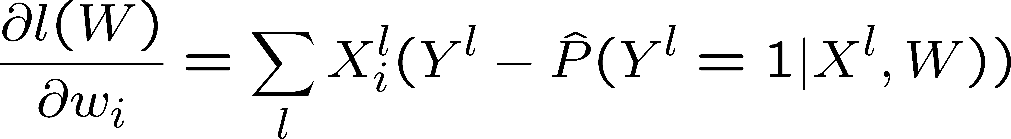

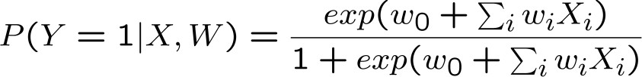
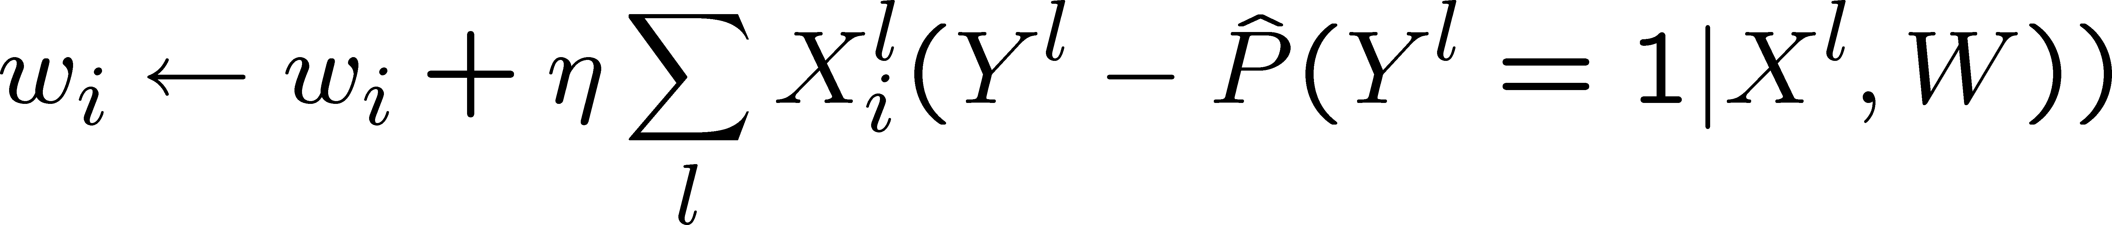
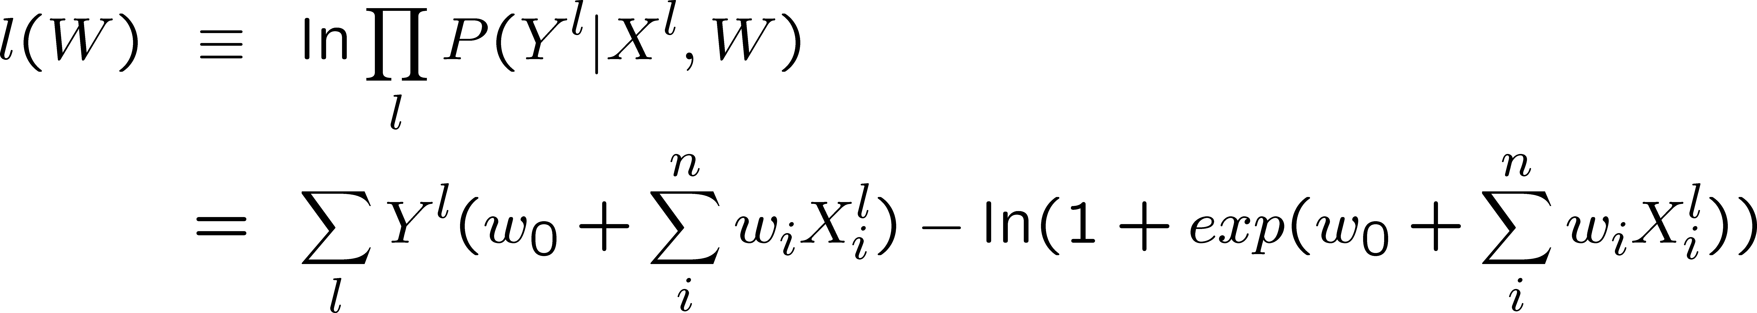
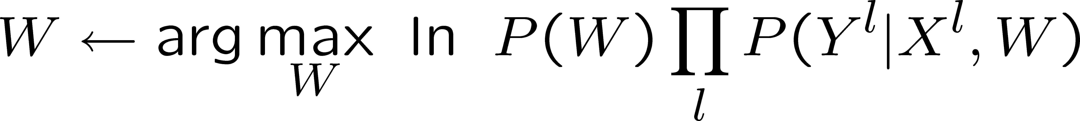
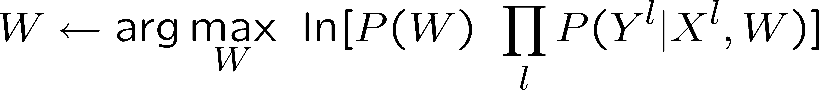
MAP and MLE
Logistic regression
MLE estimation of a parameter leads to unregularized solutions
MAP estimation of a parameter leads to regularized solutions
The prior distribution acts as a regularizer in MAP estimation
Gradient descent rule:
MAP:
BITS Pilani, Deemed to be University under Section 3 of UGC Act, 1956

Slide 10
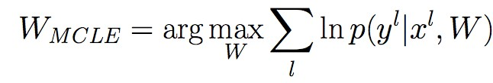
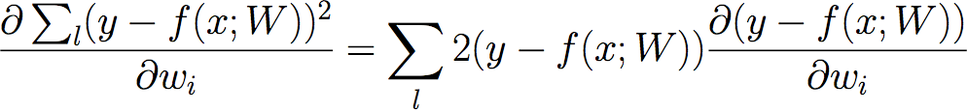
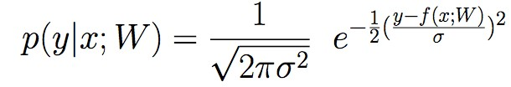
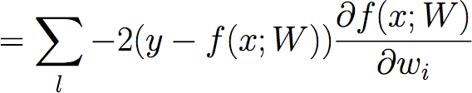

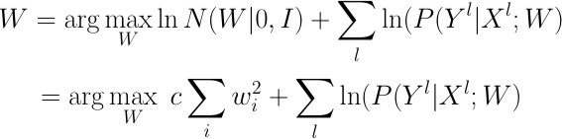
MAP and MLE
For linear regression
Maximizing MLE is equivalent to minimizing SSE
MLE estimation of a parameter leads to unregularized solutions
MAP estimation of a parameter leads to regularized solutions
The prior distribution acts as a regularizer in MAP estimation
Gradient descent rule:
where
MAP:
BITS Pilani, Deemed to be University under Section 3 of UGC Act, 1956

Slide 11
Question 1
The sales of a company (in million dollars) for each year are shown in the table below. a) Find the least square regression line y = a x + b. b) Use the least squares regression line as a model to estimate the sales of the company in 2012.
x (year) | 2005 | 2006 | 2007 | 2008 | 2009
y (sales) | 12 | 19 | 29 | 37 | 45
BITS Pilani, Deemed to be University under Section 3 of UGC Act, 1956

Slide 12
Question 2
Derive the maximum likelihood estimator (MLE) for the mean µ of a univariate normal distribution. Assume N samples, x₁, ,x_{N} independently drawn from a normal distribution with known variance σ² and unknown mean µ. Show all intermediate steps and assumptions.
BITS Pilani, Deemed to be University under Section 3 of UGC Act, 1956

Slide 13
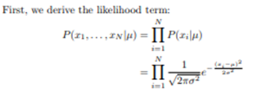
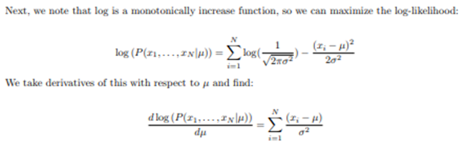
Solution 2
BITS Pilani, Deemed to be University under Section 3 of UGC Act, 1956

Slide 14
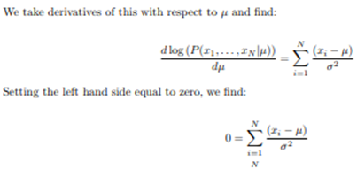
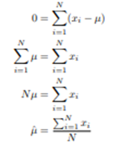
Solution 2
BITS Pilani, Deemed to be University under Section 3 of UGC Act, 1956

Slide 15
Question 3
Xi – lifetime of the jth bulb, xi – the value Xi takes
Each Xi has the pdf
BITS Pilani, Deemed to be University under Section 3 of UGC Act, 1956

Slide 16
Solution 3
BITS Pilani, Deemed to be University under Section 3 of UGC Act, 1956

Slide 17
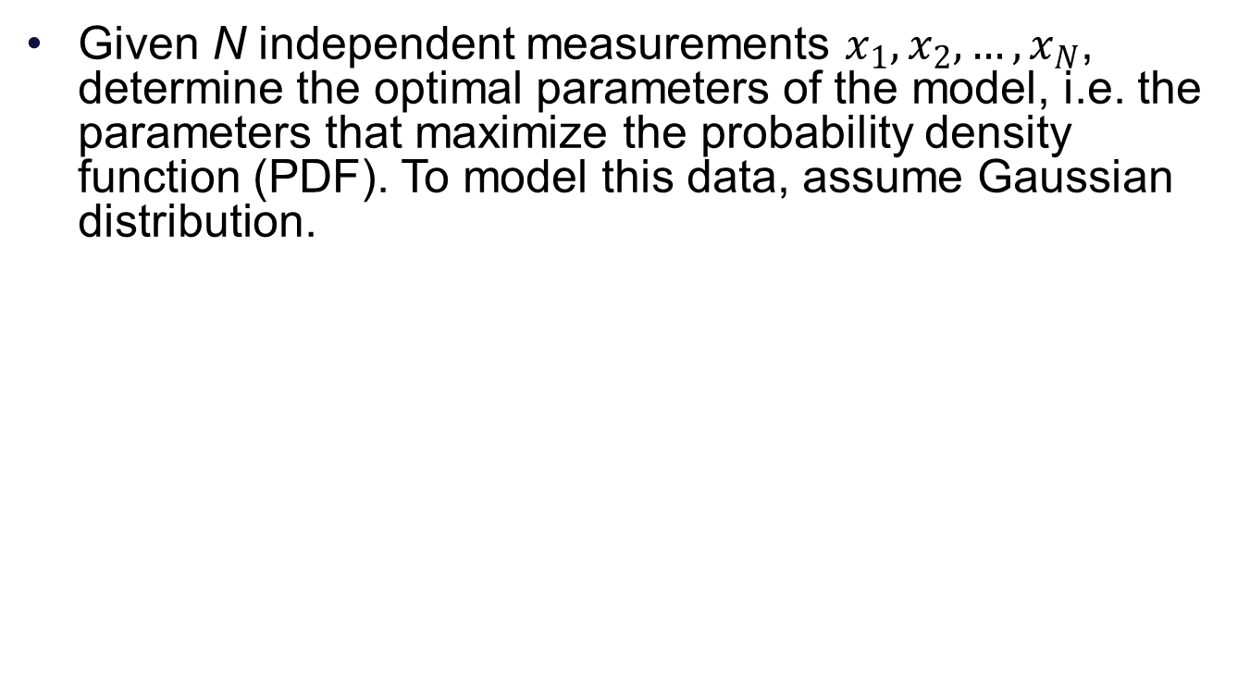
Question 4
BITS Pilani, Deemed to be University under Section 3 of UGC Act, 1956

Slide 18
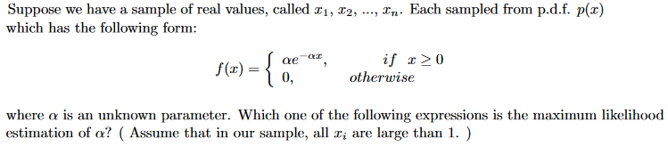

Question 5
Ans:
BITS Pilani, Deemed to be University under Section 3 of UGC Act, 1956

Slide 19
Thank you
BITS Pilani, Deemed to be University under Section 3 of UGC Act, 1956

